Slide 1
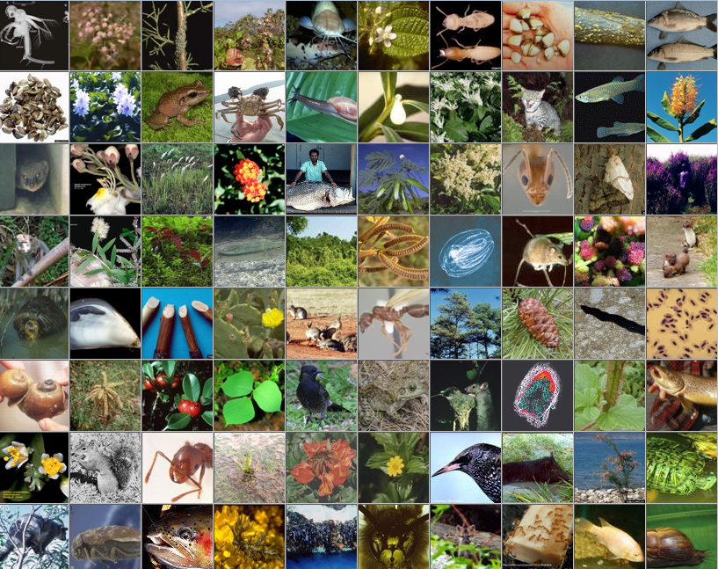
Invasive Species 1
http://www.issg.org/worst100_species.html
Notes:
Source: 100 of the World's Worst Invasive Alien Species: http://www.issg.org/worst100_species.html
2020 – this links to Global Invasive Species Database – you can click on each species individually from link above

Slide 2
Invasive Species 1
Module Learning Outcomes:
Knowledge and understanding
1. Demonstrate critical awareness of the rapidly changing status of species in the natural environment, the implications for ecosystem services, and the approaches to addressing these problems in different ecosystems.
Intellectual, practical, affective and transferable skills
3. Critically assess conservation issues and communicate scientific arguments to a wide audience.

Slide 3
Invasive Species 1
PART i
Terminology
Invasiveness
PART ii
Biotic homogenisation
Invasive species as a threat to biodiversity
PART iii
Ecological traits of invasive species
PART iv
Differences in susceptibility between ecosystems / regions
In other lectures
Effects on biodiversity / other impacts
Invasion pathways
Native invaders
Tracking and managing invasions (inc. uses of new technology)

Slide 4
Non-native species as defined by Defra
A species introduced (i.e. by human action) outside its natural past or present distribution
(includes any part, gametes, seeds, eggs, or propagules of such species that might survive and subsequently reproduce)
Notes:
4

Slide 5
Natives – the opposite
A species that is:
descended from individuals that were present in GB while humans were still hunter-gathers
or
colonized without human transport from such a population elsewhere
Notes:
5

Slide 6
Terminology
Alien
Invasive (i.e. causing ecological or economic harm)
Non-native
Adventive
Naturalised
Established
Archaeo(phyte)
arrived after start of Neolithic (i.e. about 4000 BC) but before 1500 AD
Neo(phyte)
recorded only since 1500 AD
Native
Endemic
Notes:
Archaeo(phyte) – recorded before 1500 – but not in fossil record before Neolithic (c. 4000 - 2000 B.C.)

Slide 7
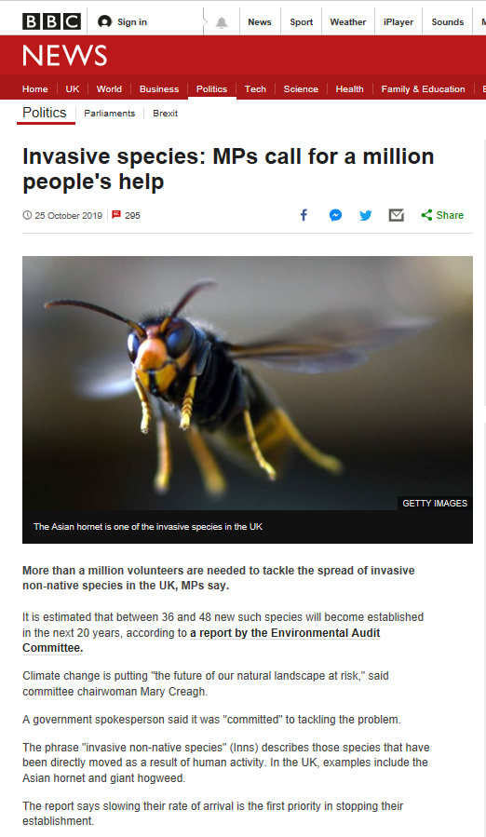
25 Oct 2019
https://www.bbc.co.uk/news/uk-politics-50173577
https://www.parliament.uk/business/committees/committees-a-z/commons-select/environmental-audit-committee/news-parliament-2017/invasive-species-report-published-19-20/

Slide 8
Are all aliens invasive?
Transportation
Tens rule (Williamson, 1996)
1 in 10 transported individuals are released...
...of those 1 in 10 establish…
…of those, 1 in 10 is invasive
So 99% of aliens are no problem?
10%
Introduction
10%
Establishment
10%
Spread

Slide 9
The numbers vary but the principle holds
Jeschke & Strayer (2005) PNAS 102: 7198–7202
Freshwater fishes, mammals and bird species native to Europe or N. America introduced outside native range
Transportation
6%
Introduction
56%
Establishment
60%
Spread

Slide 10
Establishment success - HERPTILES
Climate similarity important
But other ecological factors little-studied
Small islands more easily colonized than large islands or continents
Increased availability of empty niches?
Or pathways more prevalent on islands? (e.g. biocontrol, food use)
Kraus, F., 2011. Reptiles and amphibians. In: Simberloff, D. & Rejmǹek, M. (eds). Encyclopedia of biological invasions.

Slide 11
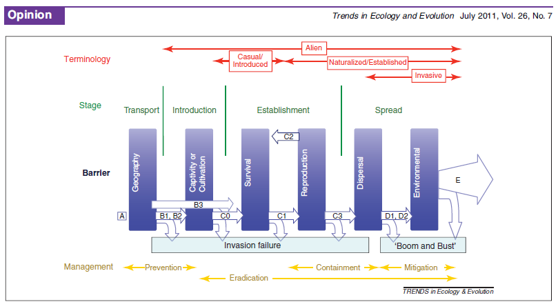
Blackburn et al., 2011. Trends in Ecology & Evolution 26(7): 333-339.
Notes:
Blackburn, T. M., et al., 2011. A proposed unified framework for biological invasions. Trends in Ecology & Evolution 26(7): 333-339
tries to update and put some standardisation to this
‘There has been a dramatic growth in research on biological invasions over the past 20 years, but a mature understanding of the field has been hampered because invasion biologists concerned with different taxa and different environments have largely adopted different model frameworks for the invasion process, resulting in a confusing range of concepts, terms and definitions. In this review, we propose a unified framework for biological invasions that reconciles and integrates the key features of the most commonly used invasion frameworks into a single conceptual model that can be applied
to all human-mediated invasions. The unified framework combines previous stage-based and barrier models, and provides a terminology and categorisation for populations at different points in the invasion process.’

Slide 12
Invasive Species 1
PART i
Terminology
Invasiveness
PART ii
Biotic homogenisation
Invasive species as a threat to biodiversity
PART iii
Ecological traits of invasive species
PART iv
Differences in susceptibility between ecosystems / regions

Slide 13
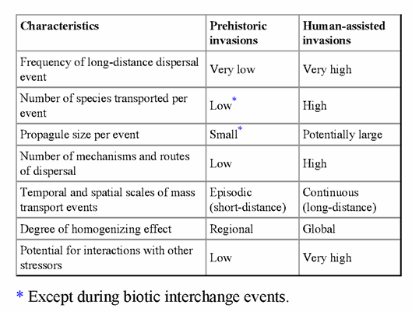
Human-assisted invasions are very different from ‘natural’ ones
Source: Olden et al., 2011. Ch. 9 in Conservation Biogeography (Ladle & Whittaker eds) (table modified from Ricciardi (2007) Conservation Biology 21: 329–336)

Slide 14

Prehistoric vs. modern establishment rates
Hawaii
before human settlement: 30 species per million yrs
after Polynesians: 20,000 per million yrs (0.02 per year)
last 200 years: 20 per yr!
(Ricciardi, 2007)

Slide 15
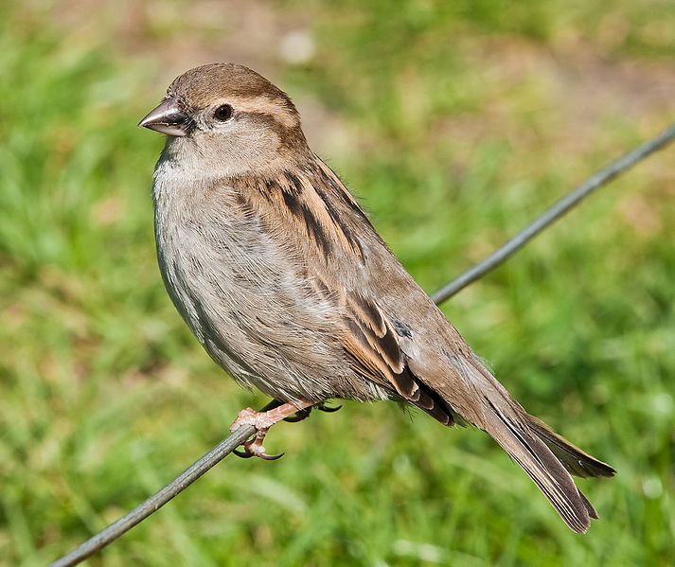
Major Conservation Issue: Biotic homogenization
i.e. if the same non-natives are being introduced to multiple locations
potential for disparate regions to become more similar in species composition over time (Olden et al., 2011)
Regionally distinct native communities are gradually replaced by locally expanding, cosmopolitan non-native communities (McKinney & Lockwood, 1999)
House sparrow Passer domesticus (Photo: David Iliff)
Notes:
Photo by DAVID ILIFF. License: CC-BY-SA 3.0

Slide 16
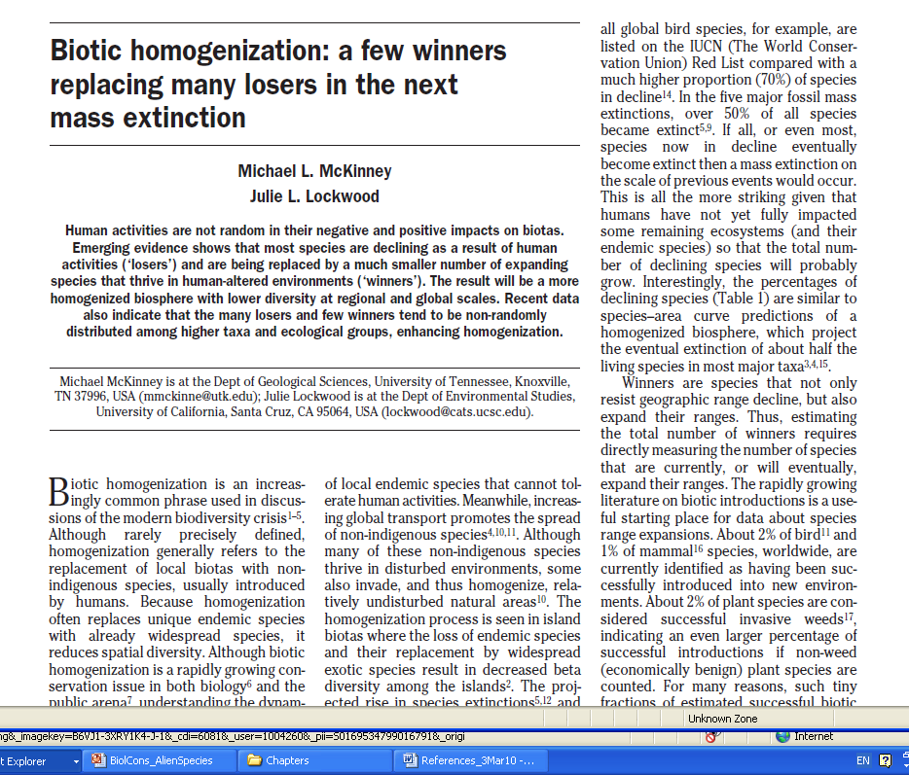
Major Conservation Issue: Biotic homogenization
TREE 14: 450-453

Slide 17
Biotic homogenization McKinney & Lockwood (1999)
“Human activities are not random in their negative and positive impacts on biotas.
…most species are declining as a result of human activities (‘losers’) and are being replaced by a much smaller number of expanding species that thrive in human-altered environments (‘winners’).
The result will be a more homogenized biosphere with lower diversity at regional and global scales.”

Slide 18
Biotic homogenization
Invasive alien species are one of the main drivers of biotic homogenization
Genetic homogenisation

Slide 19
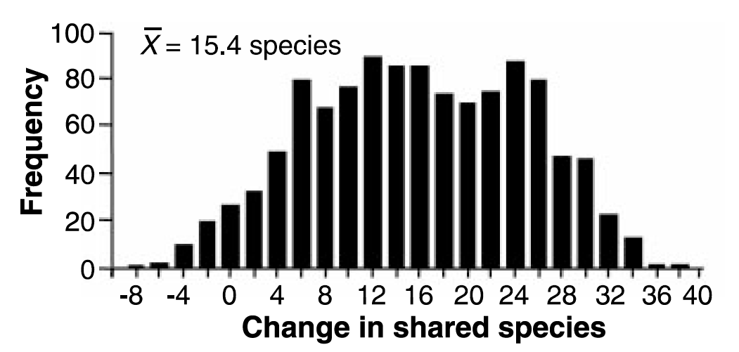
Homogenisation of freshwater fishes in US states
Rahel (2000) Science 288: 854-856
Fig. 1. Changes in number of shared species among 1128 pairwise combinations of the 48 coterminous United States. Change was measured
as current number of shared species minus historical number of shared species. On average, states share 15.4 more species now than before
European settlement of North America (=7.2% greater similarity).

Slide 20
What are the biggest threats to global biodiversity?
What are the biggest threats to global biodiversity?
Habitat loss
Climate change
Invasive alien species
Combined effects making things worse?
Climate change aiding aliens?

Slide 21
What are the biggest threats to global biodiversity?
What are the biggest threats to global biodiversity?
Habitat loss
Climate change
Invasive alien species
Combined effects making things worse?
Climate change aiding aliens?
Global human population

Slide 22
Invasive Species 1
PART i
Terminology
Invasiveness
PART ii
Biotic homogenisation
Invasive species as a threat to biodiversity
PART iii
Ecological traits of invasive species
PART iv
Differences in susceptibility between ecosystems / regions

Slide 23
Some traits of invasive species
Highly dispersive
In insects, link to large size
Highly productive
Fast life cycle
Highly competitive
Highly adaptable (eurytopic)
Habitat
Feeding (polyphagous)
Phenotypic plasticity

Slide 24
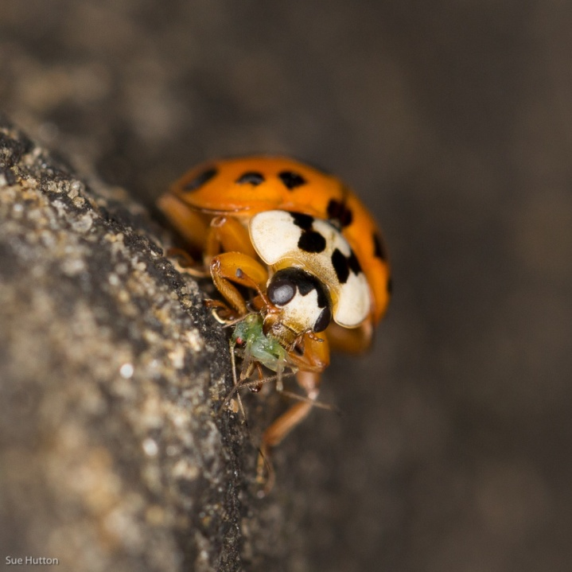
Biological characteristics of a species make it more or less likely to become a pest…
r- vs. K-selected species (quantity vs. quality)
r-selected = short life expectancy, small body size, production of many offspring, low parental care, etc
Many types of organisms can become pests...
...even slow breeding ones - but many insects have the advantage of growing their populations very rapidly
Harlequin ladybird
Image: Sue Hutton
Notes:
24

Slide 25
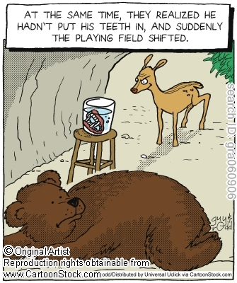
Why else do some aliens thrive?
Natural enemy escape hypothesis
Predators
Parasites
Pathogens

Slide 26
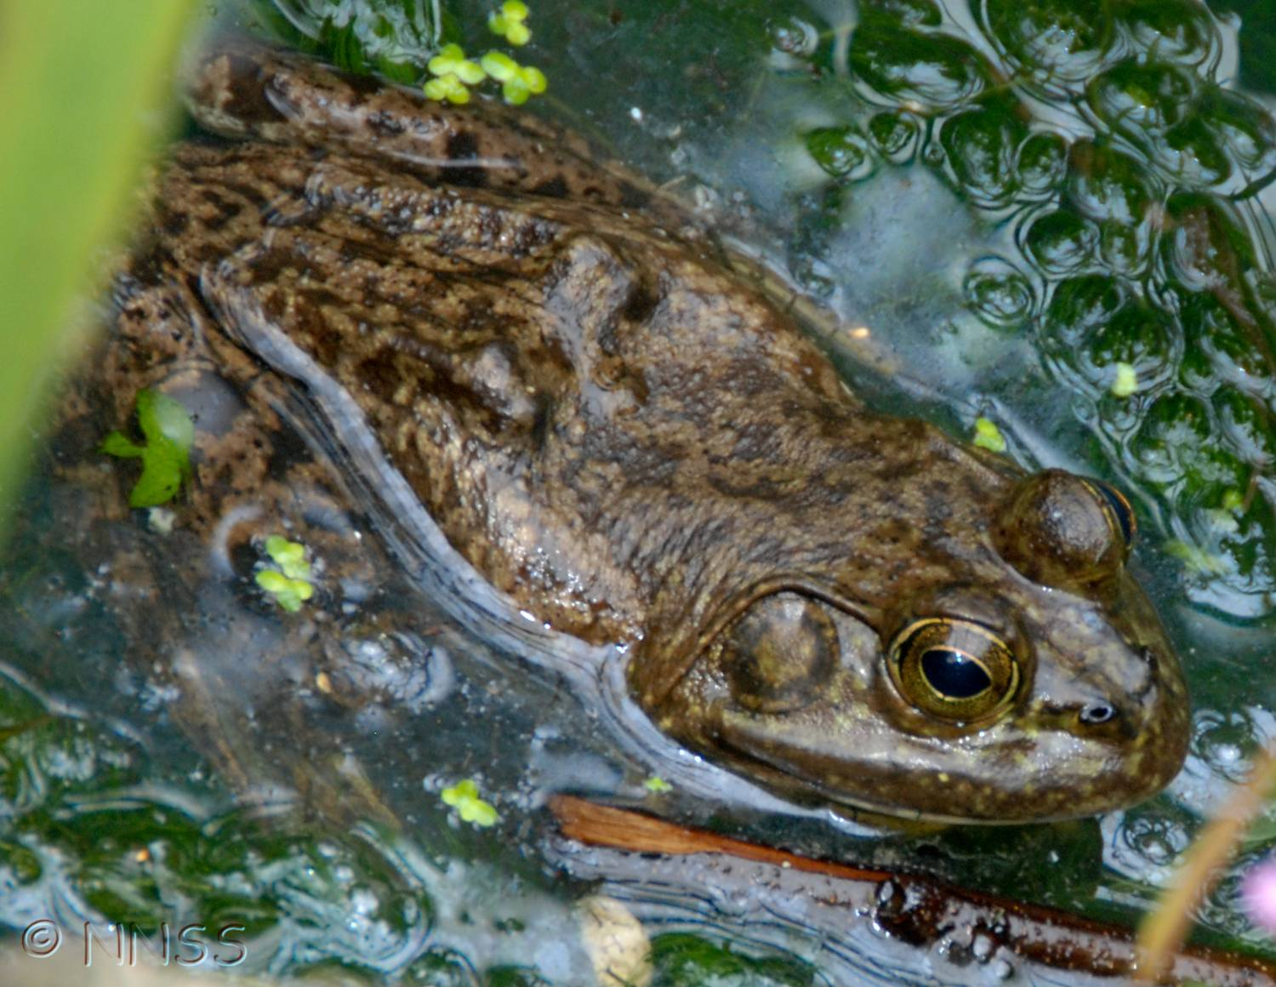
N American bullfrog Rana catesbeianus
Predator escape
in native range water snakes, alligators & snapping turtles are predators
Generalist predator
V. high fecundity
Decline of native amphibians
Vector for chytrid fungus
Notes:
Image: American bullfrog (NNSS)

Slide 27
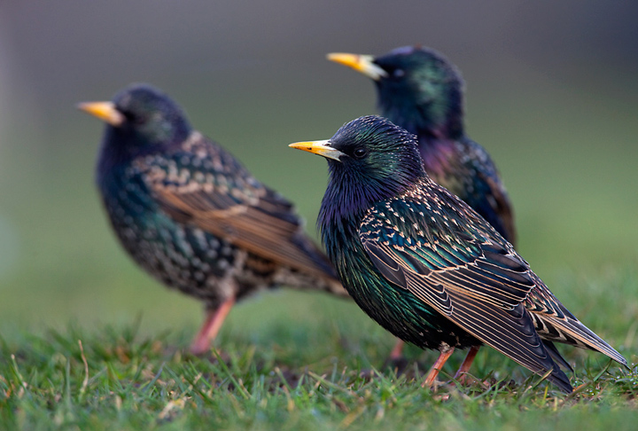

American Acclimatization Society
Shakespeare’s birds
Notes:
Starling image: http://commons.wikimedia.org/wiki/File:Sturnus_vulgaris_2_%28Marek_Szczepanek%29.jpg

Slide 28
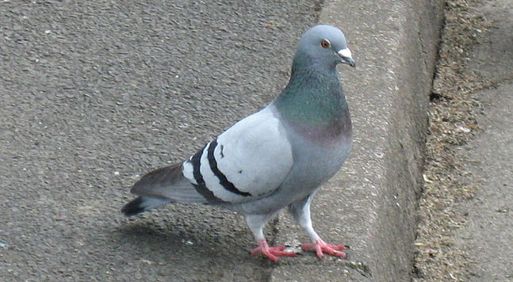
Key traits of invasive birds
High survival & reproductive success
Breeding early & throughout year (feral pigeon Columba livia)
Sociality
E.g. colonial nesting, communal roosting → predator avoidance & increased foraging & reproductive success?
Behavioural flexibility
E.g. variety of nest sites (common myna Acridotheres tristis)
Notes:
Image: http://en.wikipedia.org/wiki/File:Columba_livia.jpg
Source: Sodhi (2011) Birds. In: Encyc. Biol. Inv.

Slide 29
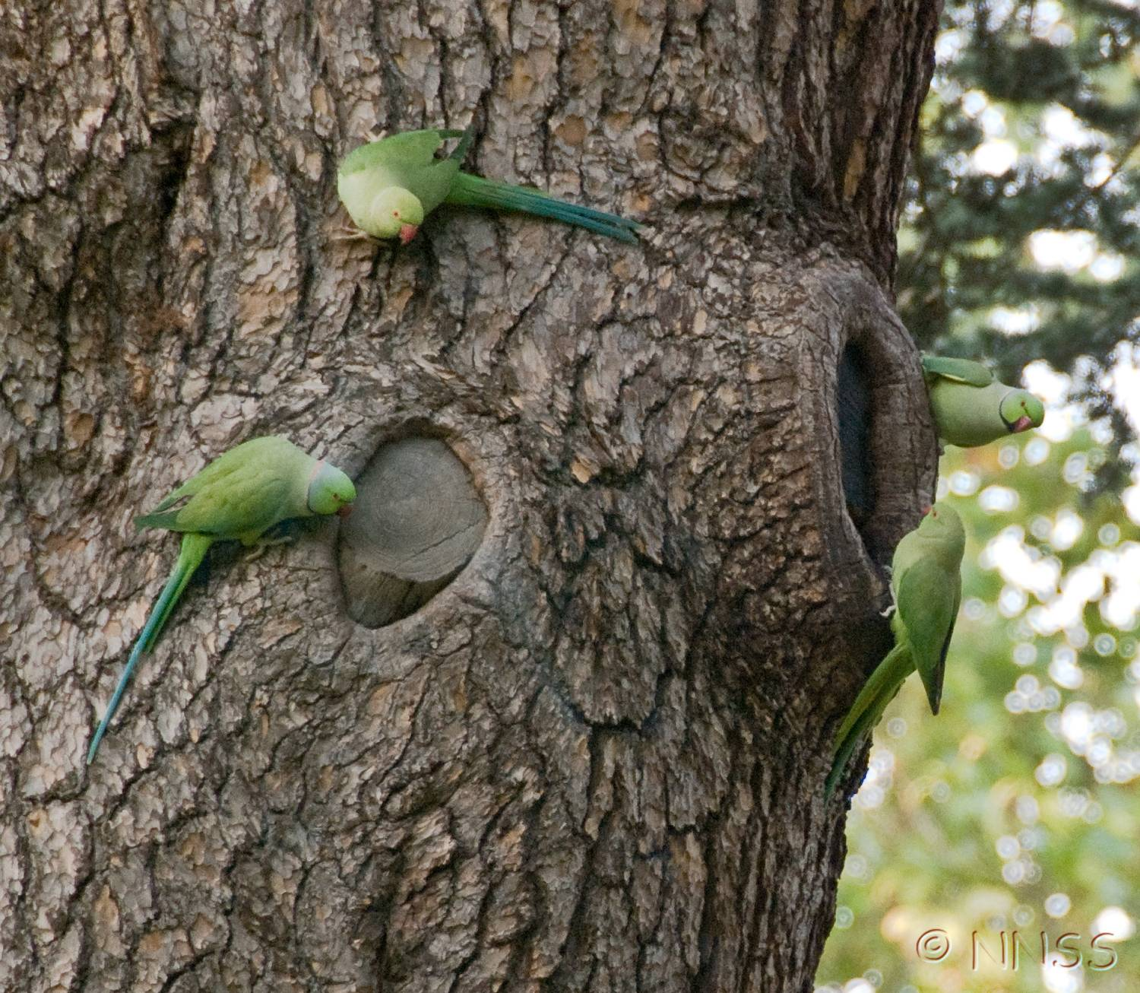
Rose-ringed parakeet Psittacula krameri
Image: NNSS
1. Enemy release hypothesis
supported by heavy nest predation in native India, cf invaded UK
2. Climate-matching hypothesis
supported by higher reproductive success in invaded Mediterranean cf invaded UK
Notes:
Source: Sodhi (2011) Birds. In: Encyc. Biol. Inv.

Slide 30
Invasive Species 1
PART i
Terminology
Invasiveness
PART ii
Biotic homogenisation
Invasive species as a threat to biodiversity
PART iii
Ecological traits of invasive species
PART iv
Differences in susceptibility between ecosystems / regions

Slide 31

Some ecosystems are more vulnerable to invasion than others
Islands
Depauperate
Few predators
Few competitors
Free niches
High endemism
Mauritius & Hawaii cf. GB

Slide 32
Some ecosystems are more vulnerable to invasion than others
In Europe patterns of habitat invasions consistent between regions
few alien plants in environmentally extreme & nutrient-poor habitats
many aliens in frequently disturbed habitats with fluctuating nutrient availability
Chytry et al. (2008) J. Applied Ecol. 45: 448-458

Slide 33
Alien species in England
N = 1413 (excludes garden species & rarer vascular plants)
Source: Hill et al., 2005 (English Nature audit)

Slide 34
Invaded habitats (England)
N = 1943 (+ 390 species have no habitat data)
Source: Hill et al., 2005 (English Nature audit)

Slide 35
Invaded habitats: Dominance of plants, animals (& fungi)
74% animals
77% plants
53% plants
63% plants
51% plants
50% animals
26% plants
24% fungi
69% plants

Slide 36
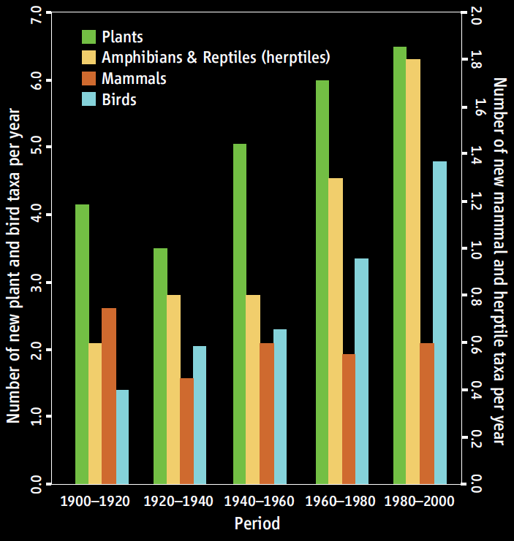
Alien taxa newly recorded as established in Europe per annum
Source: Hulme et al., 2009. Science 324: 40-41

Slide 37
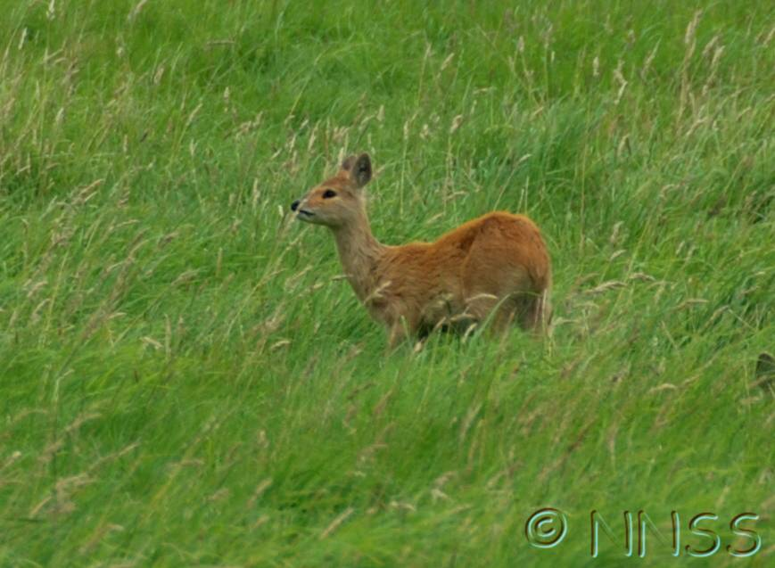
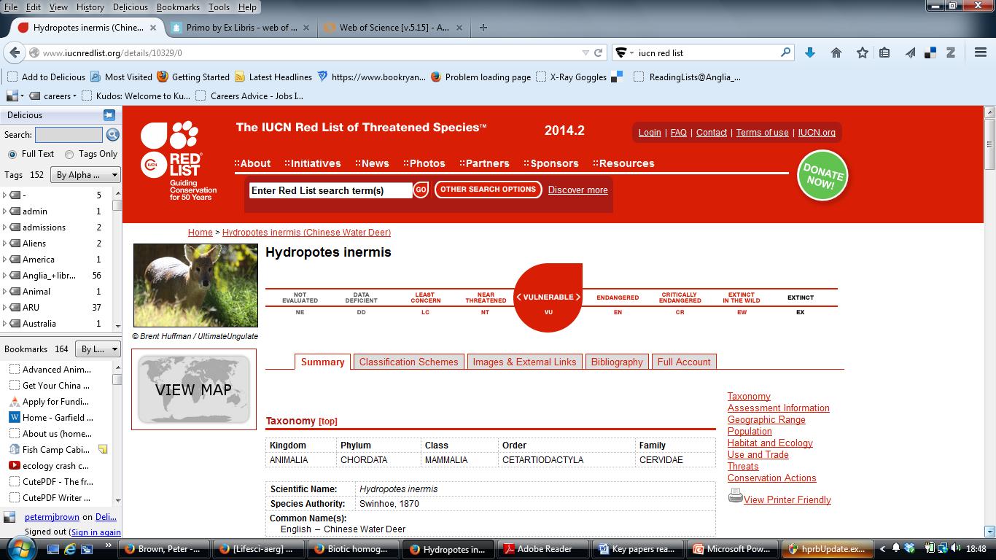
Chinese water deer – a conservation dilemma?
IUCN Red-listed
10% of global population in GB
Notes:
http://www.iucnredlist.org/details/10329/0

Slide 38
Invasive Species 1
PART i
Terminology
Invasiveness
PART ii
Biotic homogenisation
Invasive species as a threat to biodiversity
PART iii
Ecological traits of invasive species
PART iv
Differences in susceptibility between ecosystems / regions
In other lectures
Effects on biodiversity / other impacts
Invasion pathways
Native invaders
Tracking and managing invasions (inc. uses of new technology)

Slide 39
Key reading
Blackburn, T. M., et al., 2011. A proposed unified framework for biological invasions. Trends in Ecology & Evolution 26(7): 333-339.
Hulme, P., et al., 2009. Science 324: 40-41
Simberloff, D. & Rejmǹek, M. (eds) 2011. Encyclopedia of biological invasions. Berkeley: University of California Press. (Copy in the library plus available as an e-book.)
Williamson, M., 1996. Biological Invasions. London: Chapman & Hall. (Especially chapter 2.)
ALSO
GB alien fact sheets – www.nonnativespecies.org
e.g. N American bullfrog

